Slide 1


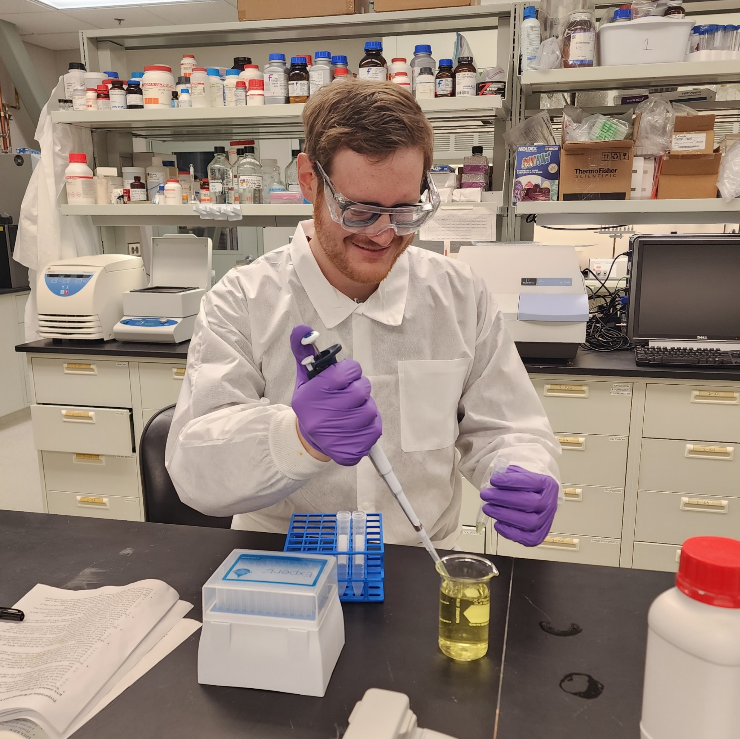
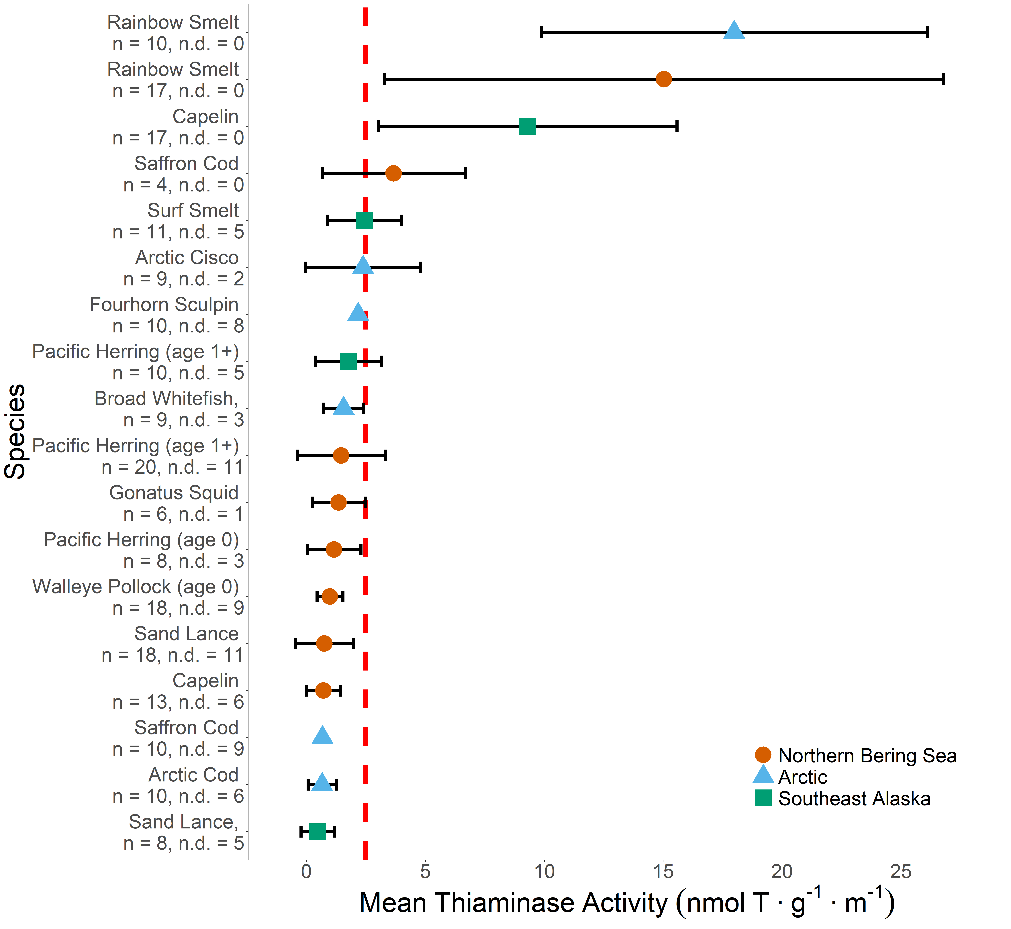
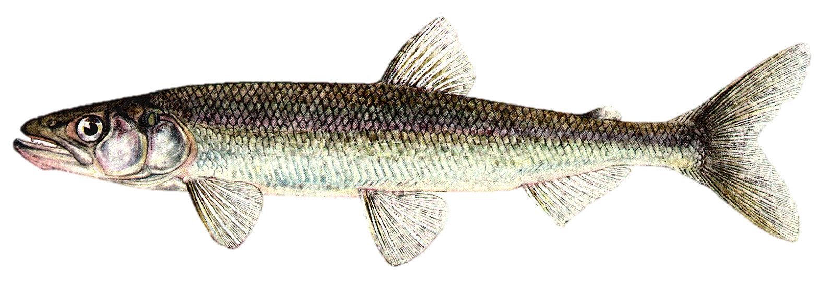
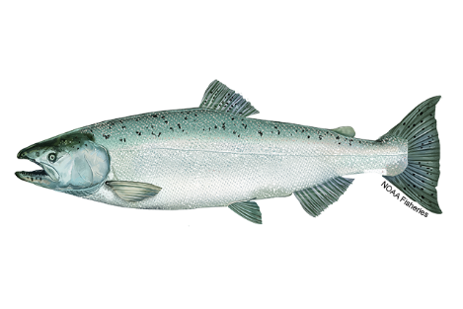
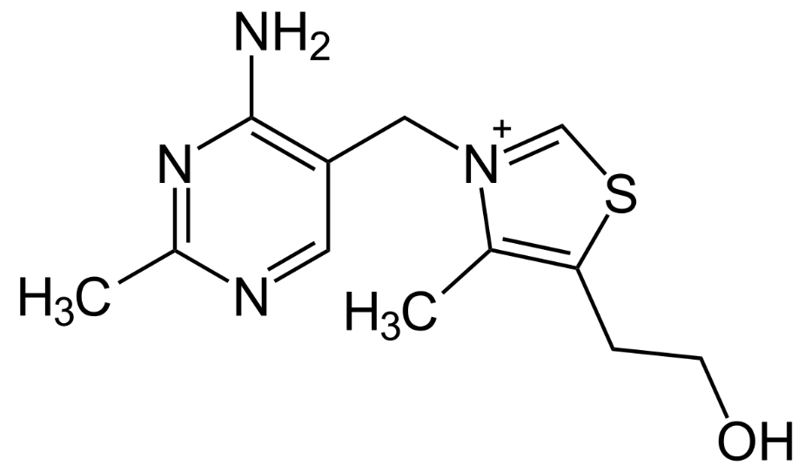
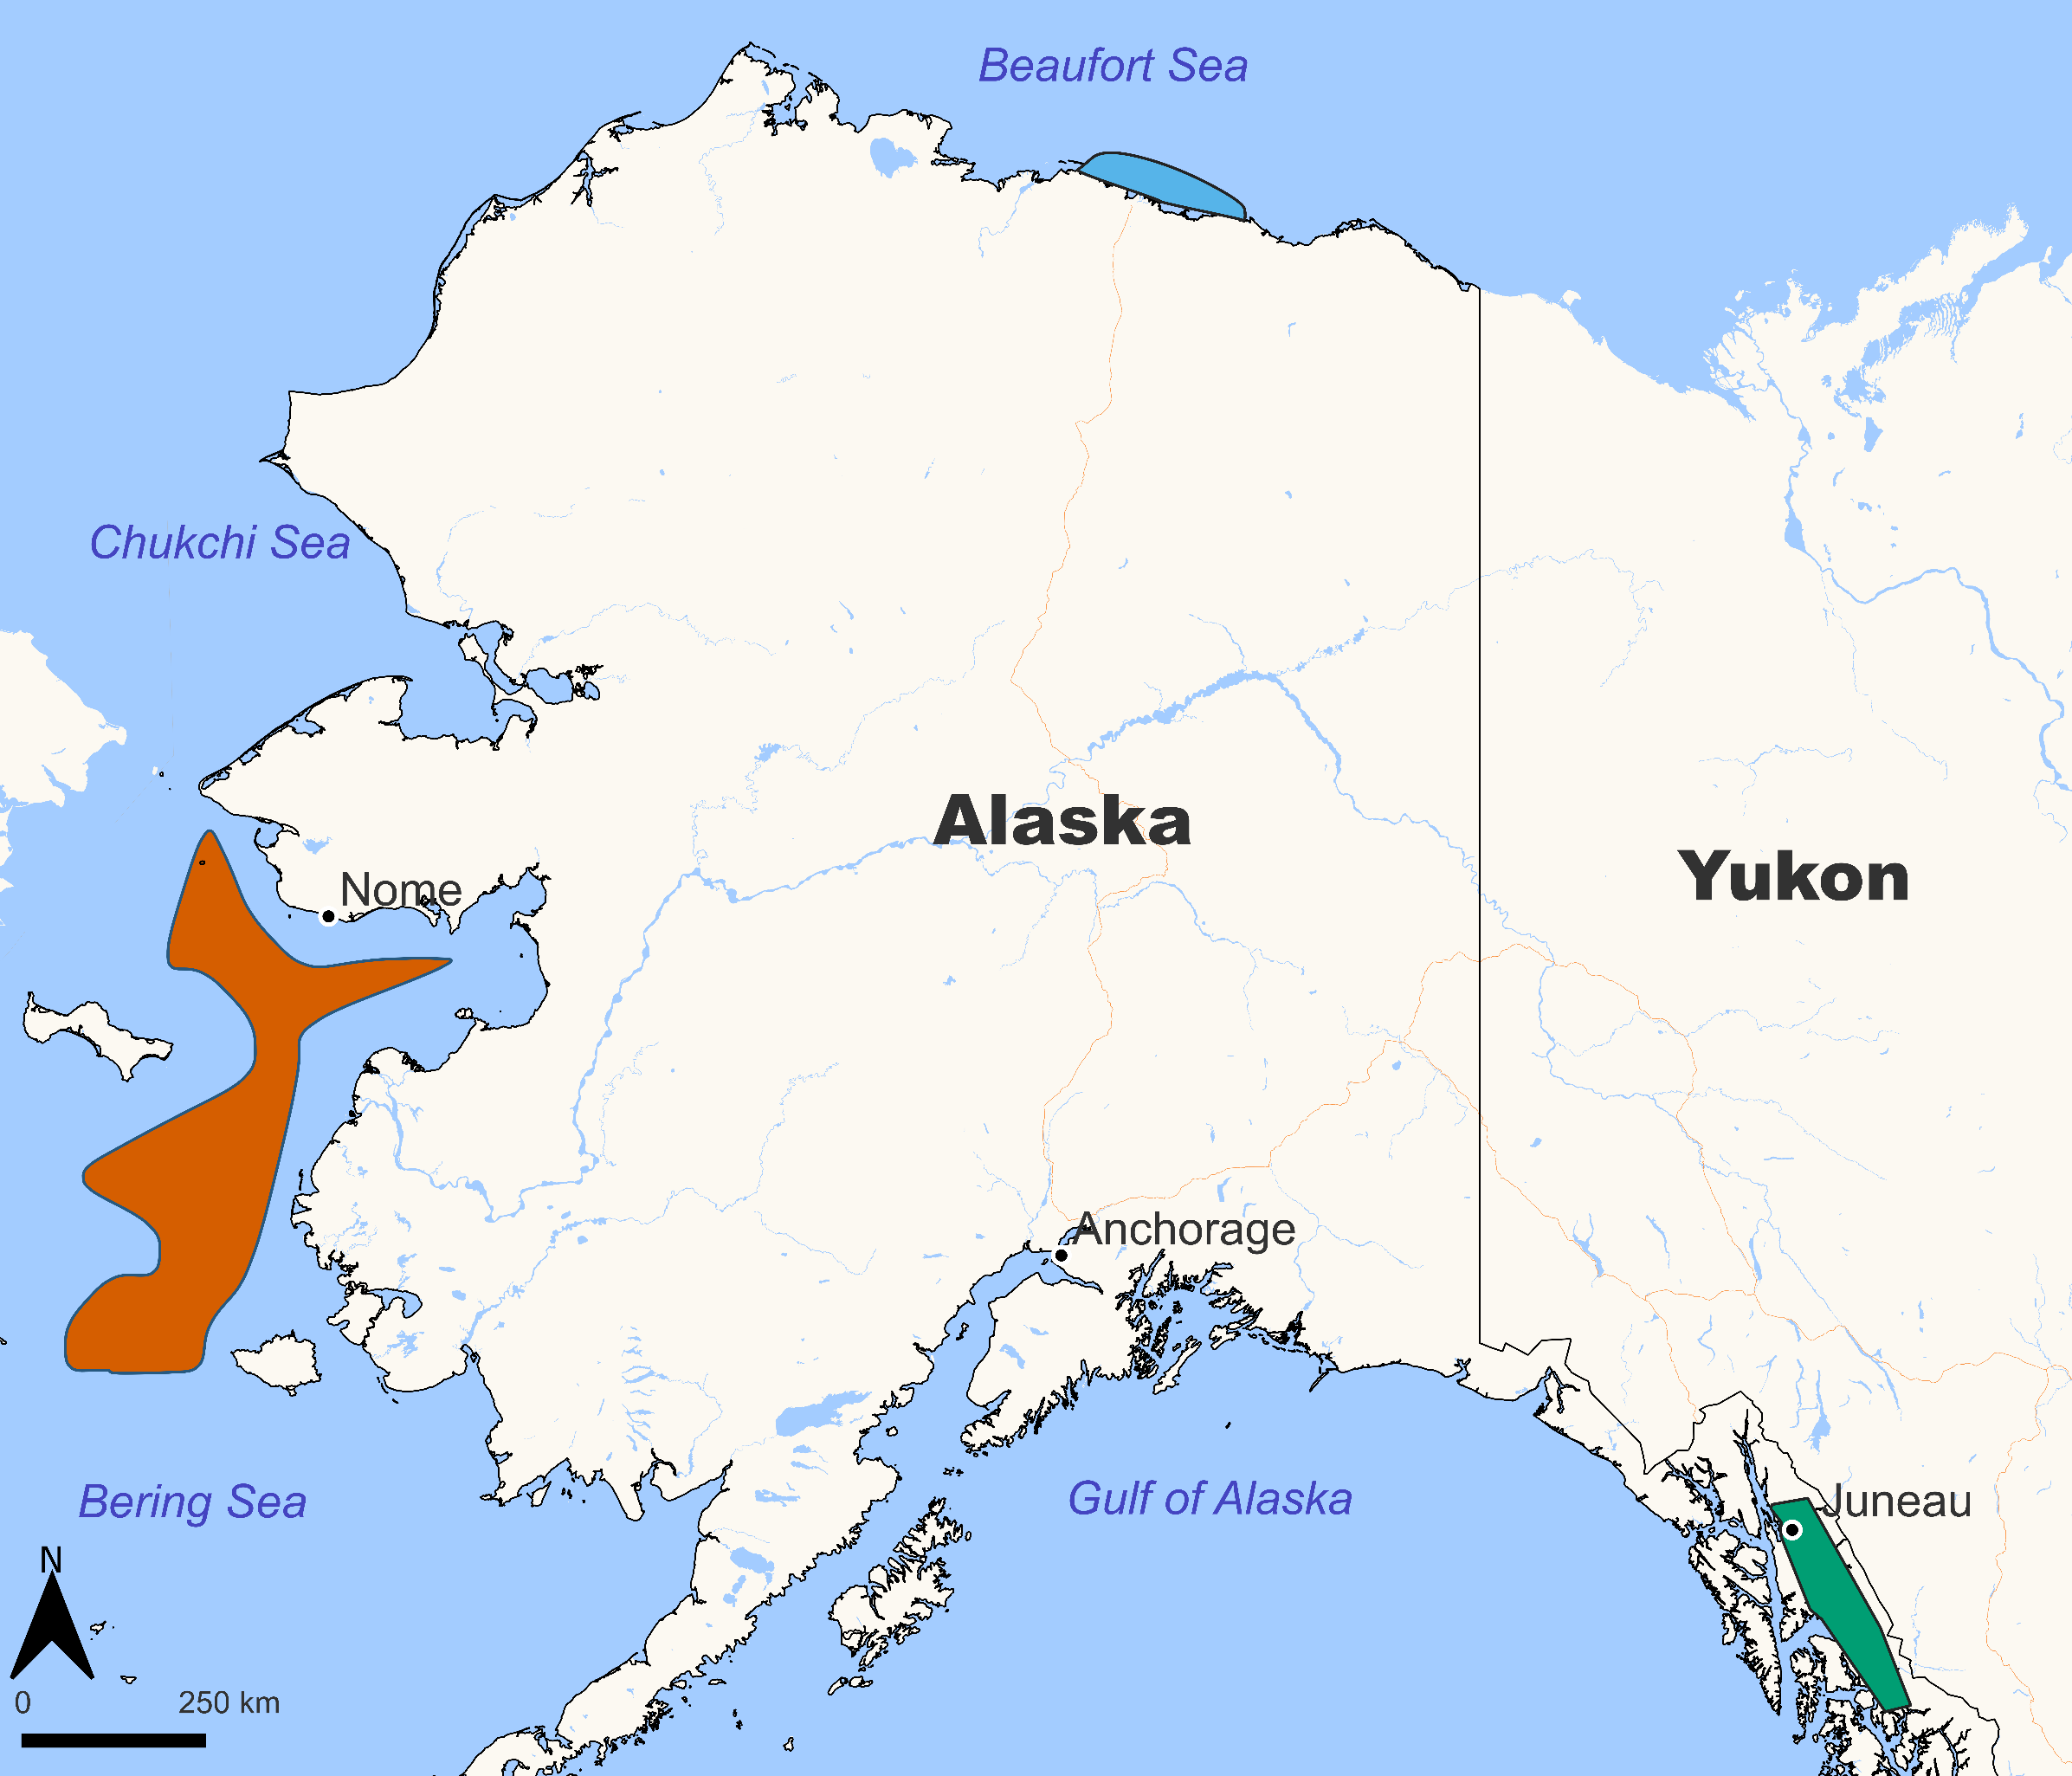
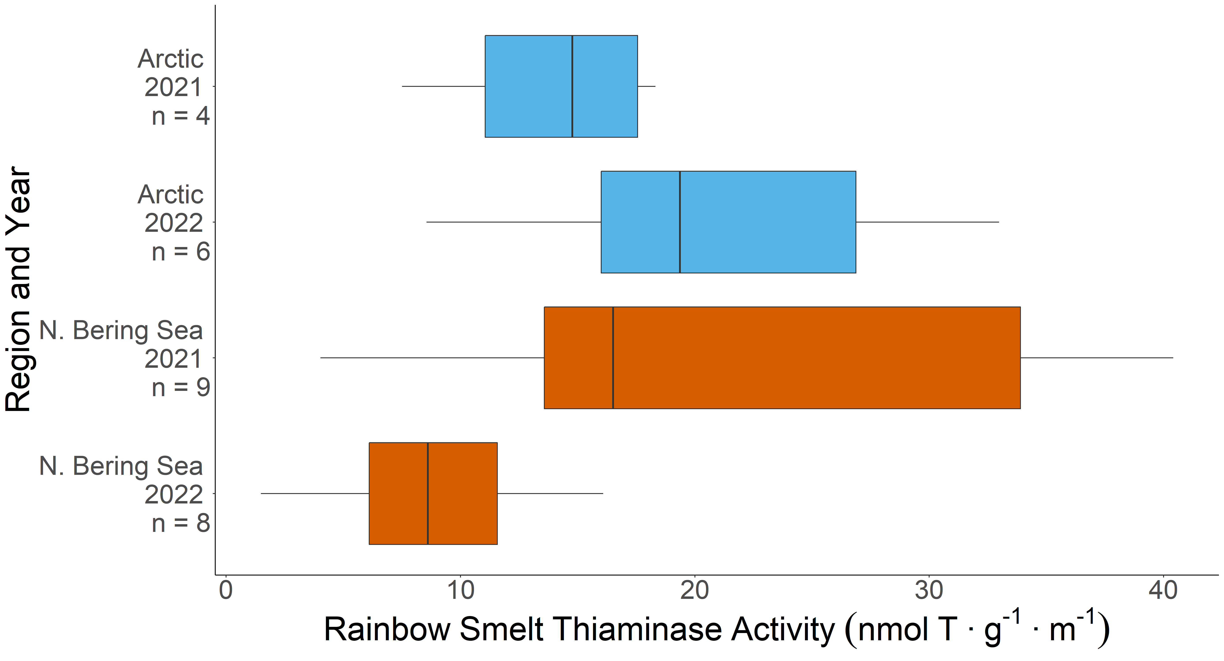
Thiaminase Activity in Alaskan Forage Fishes
Drew Porter^{1,3}, Katharine Howard², Cody Pinger³
¹Alaska Sea Grant, ²Alaska Department of Fish and Game, ³Alaska Fisheries Science Center, NOAA/NMFS
Correspondence: drew.porter@noaa.gov
OVERVIEW
RESULTS
Thiamine (i.e., vitamin B1) is an essential enzyme co-factor for cell metabolism that must be obtained through diet.
Thiamine deficiency complex has been attributed to early life stage mortality and population declines in salmonids from the Laurentian Great Lakes, California’s Central Valley, and the Baltic Sea.
Thiamine deficiency complex in salmon is hypothesized to be caused by consumption of prey fish containing thiaminase, an enzyme that destroys thiamine.
In recent years, populations of Chinook salmon (Oncorhynchus tshawytscha) in western Alaska have undergone significant population declines and reduced productivity.
Deficient levels of thiamine have been measured in eggs and muscle tissue of Chinook salmon from both Southeast Alaska (unpublished) and the Yukon River¹.
To date, thiaminase activity has not been measured in Alaska forage fish that potentially serve as a prey base for Chinook salmon.
METHODS
Frozen fish samples were homogenized and analyzed for thiaminase activity (expressed as nanomoles of thiamine degraded per gram per minute) using the rapid, spectrophotometric, 4-NTP assay².
Rainbow smelt
MAIN FINDINGS
Rainbow smelt (Osmerus mordax dentax) displayed the greatest thiaminase activity overall, and displayed regional and interannual variability, consistent with trends observed elsewhere³.
Capelin (Mallotus villosus) from the Bering Sea had much higher thiaminase activity levels than individuals from Southeast Alaska did. Notably, these populations are genetically distinct⁴.
Thiaminase activity varied by species, region, and year. Several purported prey species of Chinook salmon displayed thiaminase activity above a threshold level known to cause thiamine deficiency in consumers.
Thiamine
Chinook salmon
OBJECTIVE
Measure thiaminase activity in forage fish species collected from three different Alaska marine ecosystems.
COLLECTION AREAS
Figure 2. Mean thiaminase activity measured in species collected from Alaska marine ecosystems. Error bars = ± 1 standard deviation, n = sample size, n.d. = samples with no detectable thiaminase activity, red line = thiaminase activity threshold (>2.5 nmol T∙g⁻¹∙m⁻¹) observed to cause thiamine deficiency in consumers¹.
NEXT STEPS
A subset of individuals analyzed here for thiaminase activity levels will also be analyzed for total body thiamine and lipid content in order to develop greater insight into the quality of prey items in Alaska marine environments.
Thiaminase activity levels will be assessed in conjunction with species abundance data to develop a spatial understanding of thiaminase positive prey species in Alaska marine environments.
ACKNOWLEDGEMENTS
We thank B. Cormack assistance with the thiaminase assay. Thank you to J. Murphy and W. Strausburger for their insights and expertise. We appreciate the numerous individuals who assisted with field collection of fish samples, including D. Neff, J. Moran, W. Licht, E. Piat, S. King, F. Sewall, M. Arimitsu, and all those on the Northern Bering Sea survey. Fish samples from the Arctic were provided by V. von Biela (USGS). Leaving some room here for addl acknowledgements
REFERENCES
¹Honeyfield, D. C., Murphy, J. M., Howard, K. G., Strasburger, W. W., & Matz, A. C. (2016). An exploratory assessment of thiamine status in western Alaska Chinook salmon (Oncorhynchus tshawytscha). North Pacific Anadromous Fish Comission, Bulletin No. 6, 21–31.
²Kraft, C. E., Gordon, E. R. L., & Angert, E. R. (2014). A rapid method for assaying thiaminase I activity in diverse biological samples. PLoS ONE, 9(3), e92688.
³Tillitt, D. E., Zajicek, J. L., Brown, S. B., Brown, L. R., Fitzsimons, J. D., Honeyfield, D. C., Holey, M. E., & Wright, G. M. (2005). Thiamine and thiaminase status in forage fish of salmonines from Lake Michigan. Journal of Aquatic Animal Health, 17(1), 13–25.
⁴Dodson, J. J., Tremblay, S., Colombani, F., Carscadden, J. E., & Lecomte, F. (2007). Trans-Arctic dispersals and the evolution of a circumpolar marine fish species complex, the capelin (Mallotus villosus). Molecular Ecology, 16(23), 5030–5043.
The recommendations and general content presented in this poster do not necessarily represent the views or official position of the Department of Commerce, the National Oceanic and Atmospheric Administration, or the National Marine Fisheries Service.
Figure 1. Collection areas for Alaska forage fish species. Fish were collected from the Northern Bering Sea (orange), the Arctic (blue), and Southeast Alaska (green)
Figure 3. Thiaminase activity measured in Rainbow smelt collected from two Alaska marine ecosystems over two years.
Notes:
Notes:
In Powerpoint, click View > Guides
Keep text within gutter guides.
Author list: Don’t split names onto two lines (e.g., “Jimmy [break] Smith”). If that happens, use a new line, unless you need the space. Bold the first names of anybody who’s presenting in person.
Intro/methods/result: Do not drop below font size 28, but if you have extra space, jack up the font size until the space is full.
Do not use color in the sidebars except in graphs/figures. It’ll pull attention from the center and slow interpretation for passersby.

